Slide 1
Voice-Controlled Thumper Vehicle
Milestone IV - Second Prototype
Ahmed Leithy 900160088
Yahia Farid 900161331
Yousef Koura 900160083

Slide 2
Post-Milestone III Tasks
Use and test new sound detector ✔️
Train/find a model for speech recognition (microspeech) ✔️
Integrate all aforementioned components together ⌛

Slide 3
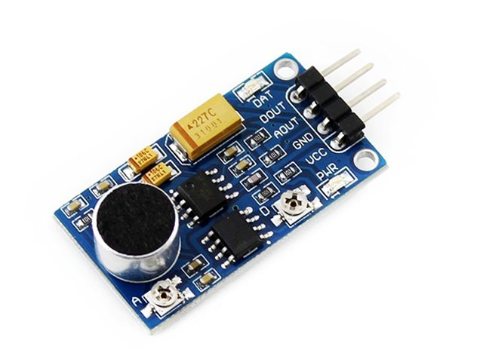
Sound Detector
Tested the sound detector upon arrival
Microphone output looks correct
Tested on small sampling rate (1KHz) for now until we integrate with microspeech
Digital output pin → Indicates when sound starts

Slide 4

Simple Test

Slide 5
MicroSpeech
Severely hindered our progress as it took days to get it to work
Tried out the X-Cube-AI package (dead-end)
Pivoted back to STM32CubeIDE
Utilized examples in TFLite for microcontrollers repo
Collated libraries needed by microspeech example and integrated them into the project
Produced a working speech recognition model

Slide 6

MicroSpeech
Adapted a test found on the TFLite for microcontrollers repo
Feeds pre-generated spectrograms for “yes” and prints the class scores
Repeats for “no”
Tested a model pre-trained on “yes” and “no” and confirmed the output
Used a Google Colab notebook found on the repo to train a model from scratch on “go”, “stop”, “left”, and “right” for future milestone and performed the same test to confirm outputs
All tests were run directly on the microcontroller (L432KC)

Slide 7
Next Stage
Integrate the thumper, sound detector and model together for final submission

Slide 8
Thank You!

